Slide 1
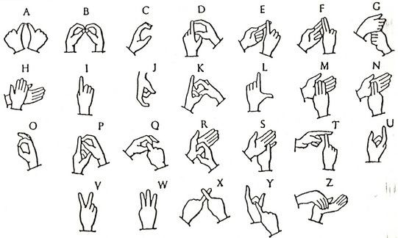
Indian Sign Language Recognition

Slide 2
TEAM MEMBERS
19K41A0520 – Shiva Sowmya
19K41A0532 – Anu
19K41A0539 – Anjali Kiran
19K41A0540 – Sai Srujan
Under the Guidance
Dr. Praveen
Associate Professor School of CS & AI SRU

Slide 3
CONTENTS
Sign Language
Project Objectives
Need Of Sign Language Recognition System
Existing Methods
Drawbacks Of Existing Models
Proposed Model
Results
Conclusion & Future scope

Slide 4
Sign Language
Communicating Language primarily used By deaf People
Uses Visual Gestures and Signs rather than Vocals For Communicating Purpose
There Exists many Sign languages all over the world, mainly American, British, Indian, Japanese and many more.

Slide 5
PROJECT OBJECTIVES
One of the major challenges that hearing-impaired people face in the present society is communication.
The use of sign language interpreters is not a best solution to this issue as it needs the other person to know the Sign language.
The major goal of this research is to develop a Neural Network-based ISL(Indian Sign Language) identification model for deaf and dumb people.
To detect the alphabets, which are represented in ISL with atmost accuracy.

Slide 6
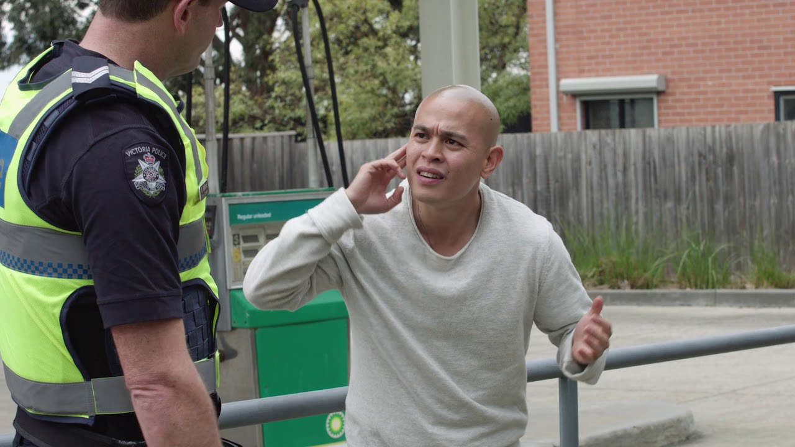
Need of Sign language Recognition
Imagine a deaf and mute person, whose belongings are robbed by a thief and Now he want to complain to a police officer. Then How would he communicate with him ?
Physically impaired people like deaf and dumb people use Sign language for communication.
Sign language is a boon for deaf and dumb people. But many of the people in society don’t understand sign language as they don’t learn it.
So to build a bridge between physically challenged people and people who don’t understand sign language we definitely need a system that recognize the signs
Sign language Recognition system:
Captures the Signs shows by the person
Converts the Signs to text

Slide 7
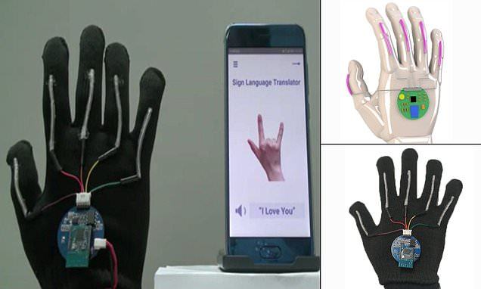
Existing Approaches
Many Researches have been taken place on Sign language Recognition Systems.
Research In Sign language Primarily has 2 approaches
Glove based System
Image Processing and Recognition
Glove Based System:
In Glove Based System user needs to wear a glove that consists of sensors and motion Trackers.
It compares with the data directly from sensors based on our finger movements

Slide 8
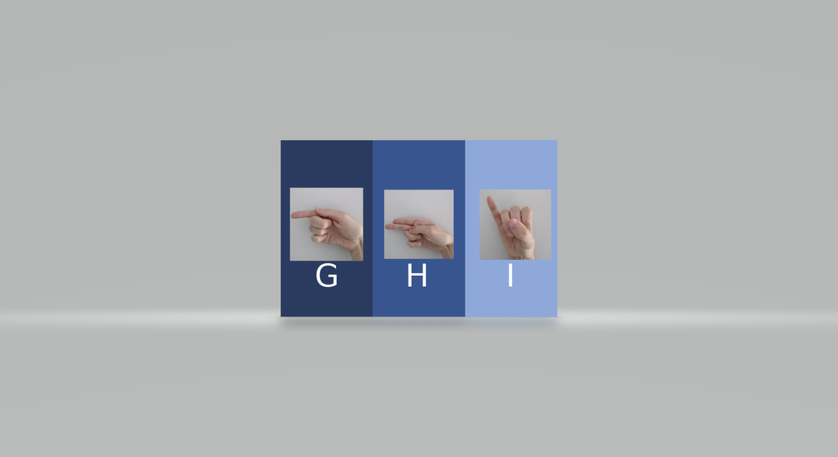
Existing Approaches(cont.…)
Image Processing and Recognition:
Image recognition uses a Camera to Capture Images or Video
It Compares the data With the Images Existing and Recognizes the sign .

Slide 9
Drawbacks of Existing Models
Most of the Recognition Systems are designed For American Sign Language
Captures Only One Hand
Mostly uses Gloves or wrist Bands
Costly Equipment’s

Slide 10
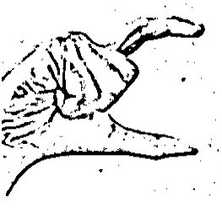
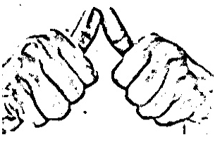
DATASET
We collected approximately 6500 images with the help of laptop, webcam and openCV library.
As there are many datasets available in internet. But they were not reliable.
Our dataset is divided into 2 parts in the ratio 70:30. Training dataset contains 5200 images and testing dataset contains 1300 images.

Slide 11
PROPOSED MODEL
We developed a custom CNN model, if we divide the whole model into two layers : top layer and bottom layer. Bottom layer consists of convolutional layers and top layer is fully connected network. Bottom layer consists of pair of three convolutional and pooling layers. And top layer consists of 5 hidden layers and one output layer with 26 neurons ( because the model has to classify 26 alphabets ).
For our proposed model we have created custom dataset of 26 alphabets which are signed in Indian sign language. 250 images are collected for each alphabet.

Slide 12
CNN MODEL ARCHITECTURE
Step-1 : Initializing CNN model to Sequential().
Step-2 : Adding 1st Convolution layer and Pooling layer with 32 neurons, input shape of 224 X 224 and activation function ‘relu’.
Step-3 : Adding 2nd Convolution layer and Pooling layer with 64 filters.
Step-4: Adding 3rd Convolution layer and Pooling layer with 64 filters.
Step-5 : Flattening the layers.
Step-6 : Making full connection by using 5 Dense layers and 1 output layer.
Step-7 : Compiling CNN model with ‘adam’ optimizer and loss function is categorical_crossentropy.
Step-8 : Fitting CNN model to images by using training data, validation data and 30 epochs as parameters.

Slide 13
CNN ARCHITECTURE(cont..)
The First hidden layer or dense layer contains 128 neurons
Second hidden layer contains 112 neurons.
Third contains 96 neurons with activation function relu.
Fourth contains 80 and Fifth hidden layer contains 64 neurons respectively.
26 neurons are in the output layer to classify the images into 26 defined classes.
We considered a “softmax” activation function in the output layer because it is widely used for classification problem.
In the proposed model we used “adam” optimizer for reducing the training time

Slide 14
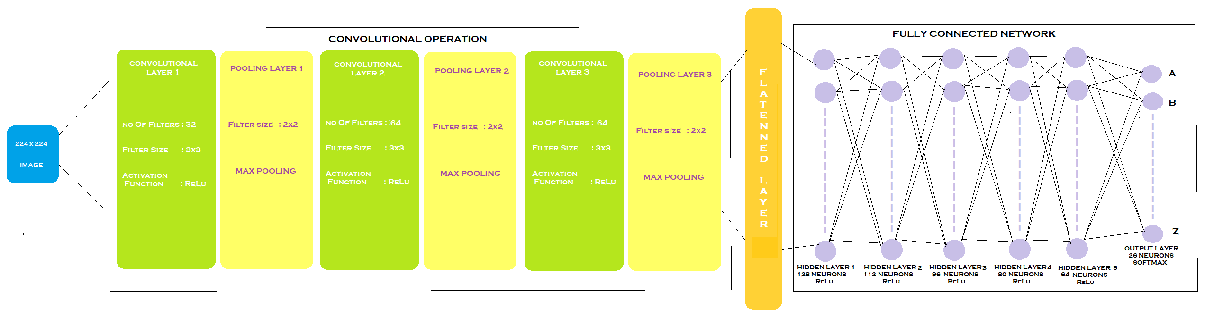

Slide 15
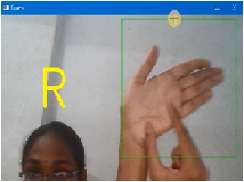
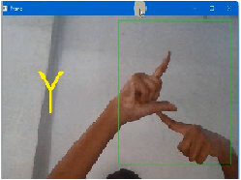
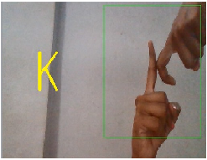
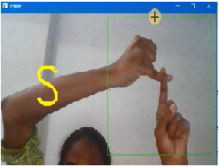
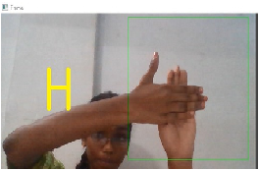
RESULTS:

Slide 16
RESULTS (cont…):
For evaluating the performance of the proposed model training and testing accuracies are very useful.
To get better accuracy the model needs to be trained using different epochs.
We trained the data set using our custom CNN architecture.
We used 30 epochs to train the data.
We found the accuracy of our proposed model is 98%.
Epochs | Train accuracy | Validation accuracy
1 | 49.7 | 99.7
5 | 96.1 | 99.5
10 | 98.3 | 99.6
Epochs | Train loss | Validation loss
1 | 1.64 | 0.02
5 | 0.12 | 0.02
10 | 0.06 | 0.02
15 | 0.03 | 0.02
20 | 0.03 | 0.02
25 | 0.01 | 0.02
30 | 0.01 | 0.02

Slide 17
CONCLUSION & FUTURESCOPE
We have collected our own dataset and we developed custom CNN model to predict the images. We found that the accuracy of our custom CNN model is 98%.
The idea Proposed in the Project Uses CNN algorithms for feasible communication between deaf and normal People by recognizing Indian Sign Languages and convert them into Text. This helps Normal people to understand the Meaning behind those Signs
But If Normal People wants to convey message to deaf and dumb people, It is quiet difficult to translate. So we can make a Two way Conversation By adding other module that converts text or speech to Sign language

Slide 18
THANK YOU

